Slide 1
Why reverse Lookup?
INDEX() with MATCH()

Slide 2
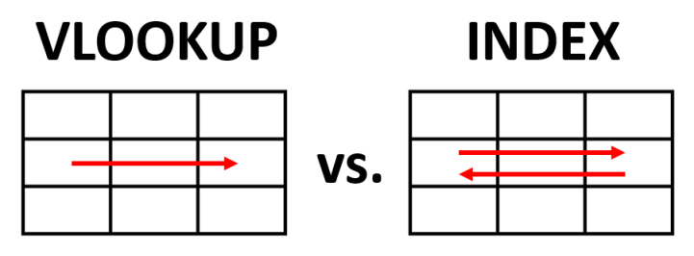
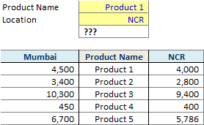
Situation that needs reverse lookup

Slide 3
